Slide 1
Credit Card Fraud Detection
Submitted By:-
Atharva Diwan (190100028)
Samyak Ajmera (19B080023)
Ankit Yadav (190100019)
Parag Bajaj (190100088)
Abhinav Singh (19D180002)
Github Repo Link: https://github.com/atharva-diwan/credit_card_fraud_detection_cs419.git

Slide 2
Motivation
Cybersecurity is becoming increasingly important. When it comes to digital security, the most difficult task is detecting unusual activities.
Credit limit in credit cards sometimes helps us make purchases even if we don’t have the amount at that time.
These features are misused by cyber attackers
.
We need a system that can abort the transaction if it finds fishy

Slide 3
Libraries, Data Processing & Understanding
The exact variables are not disclosed due to security concerns, however they have been modified versions of PCA. As a consequence, there are one time, 29 feature columns and one final class column to be found.
The dataset is imbalanced towards a feature “legit transaction”.
Our dataset has no null values
The mean amount of Fraudulent transactions is greater than the legit
We removed duplicate transactions

Slide 4
Training data & Test data - Splitting data
Since our dataset is significantly unbalanced, we first undersample the data from the majority class.
We upsample the minority class using SMOTE and build a sample dataset containing similar distribution of normal transactions and Fraudulent Transactions
We divide the data into two datasets - training data and testing data

Slide 5
SMOTE
SMOTE starts by picking a minority class instance at random and then looking for its k closest minority class neighbours.
The synthetic instance is then constructed by randomly selecting one of the k nearest neighbours b and connecting a and b in the feature space to form a line segment.
The synthetic instances are created by combining the two chosen examples a and b in a convex way.

Slide 6
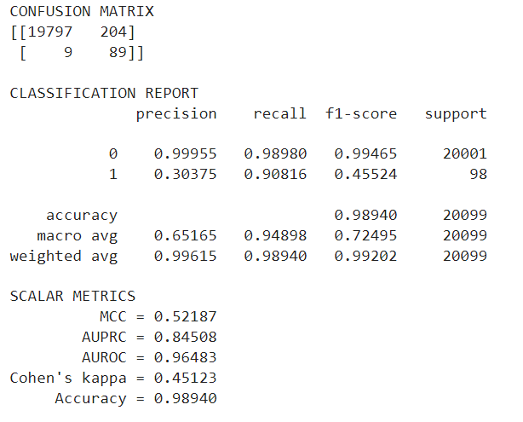
Model Building - Logistic Regression, SVM
It is memory efficient as it uses a subset of training points in the decision function
Uses SGD learning to create regularized linear models
Data should have a zero mean and unit variance for the best results when using the default learning rate schedule

Slide 7
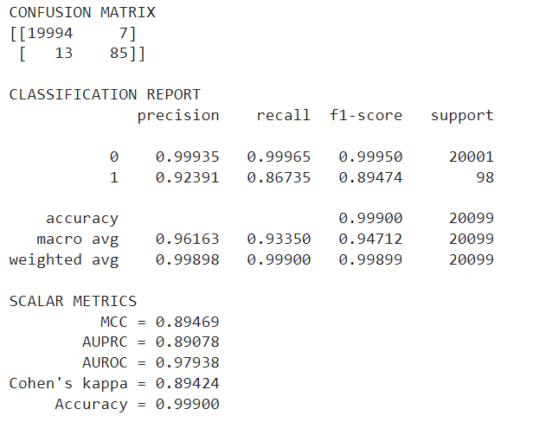
Model Building - Random Forest
Uses numerous decision trees to classify data
It employs bagging and feature randomization in order to generate an uncorrelated forest of trees
There needs to be some actual signal in our features
The predictions made by the individual trees need to have low correlations with each other

Slide 8
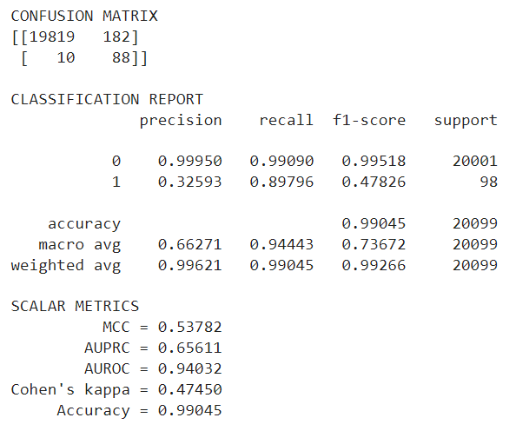
Model Building - Decision Tree
Most powerful and popular tool for classification and prediction
Each internal node denotes a test on an attribute
Each branch represents an outcome of the test
Each leaf node (terminal node) holds a class label

Slide 9
Conclusion
We find that the best model which gives highest accuracy in test data is Random Forest
Found that the five variables most correlated with fraud are, in decreasing order, V17, V14, V10, V12, and V11
The decision tree achieved MCC score of 0.53, and a random forest achieved a cross-validated MCC score of 0.89

Slide 10
References and Resources
YouTube: https://www.youtube.com/watch?v=NCgjcHLFNDg
Source Dataset: https://www.kaggle.com/mlg-ulb/creditcardfraud
Websites: https://www.geeksforgeeks.org/ml-credit-card-fraud-detection/
https://scikit-learn.org/

Slide 11
THANK YOU

